Slide 1
Content
GENERIC
ANONYMOUS CLASS
LAMBDA EXPRESSION
FUNCTIONAL INTERFACE
JAVA STREAM

Slide 2
Generic

Slide 3
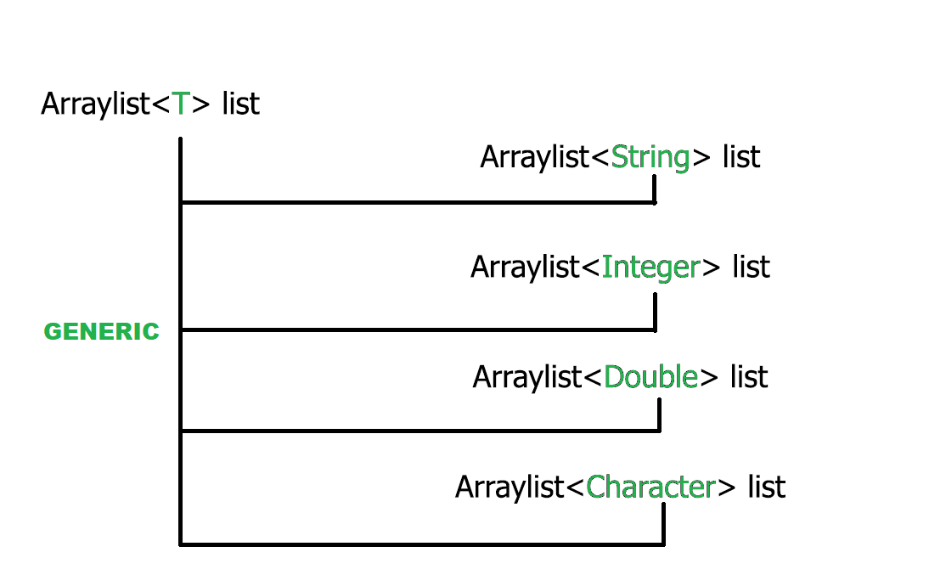
GENERIC
Generic là gì ?
Generics trong java là một cách để xác định các kiểu dữ liệu cụ thể cho các lớp và phương thức trong ngữ cảnh khác nhau.

Slide 4
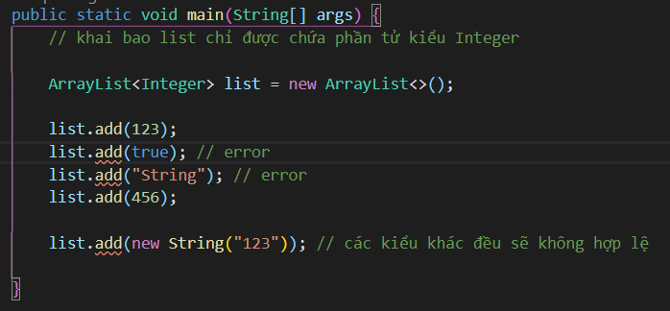
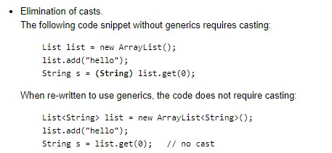
GENERIC
Tại sao chúng ta nên sử dụng generic ?
- Vì sử dụng Generic sẽ có một số lợi thế như
+ Kiểm tra kiểu dữ liệu luôn trong quá trình compiler.
+ Không cần ép kiểu trả về
+ Tái sử dụng code: Chúng ta có thể viết method, class
hoặc interface sử dụng generic và chúng ta có thể
sử dụng đoạn code này với các type-parameter khác nhau.

Slide 5
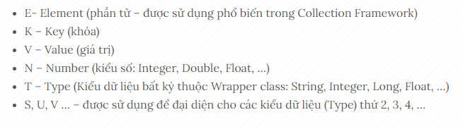
GENERIC
- Một số cách đặt tên kiểu tham số mà chúng ta nên follow theo

Slide 6
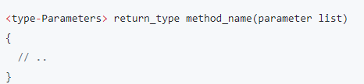
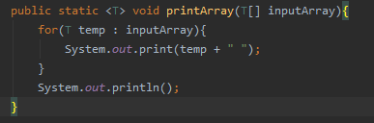
GENERIC
Generic Method
+ Generic method là những method được viết để có thể được gọi các đối số có kiểu dữ liệu khác nhau.
+ Một số rule để định nghĩa Generic Method
Generic method có một kiểu dữ liệu tham số đầu vào được khai báo trước kiểu dữ liệu trả về.
Kiểu dữ liệu tham số đầu vào có thể được giới hạn.

Slide 7
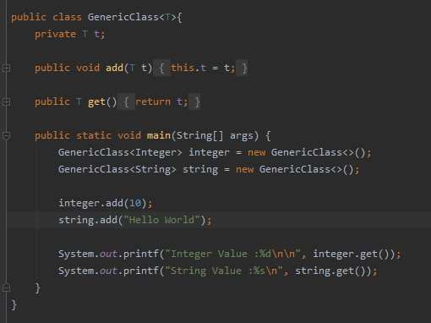
GENERIC
Generic Class
Generic class được khai báo như class thông thường, chỉ khác là có thêm phần <type-parameter>

Slide 8
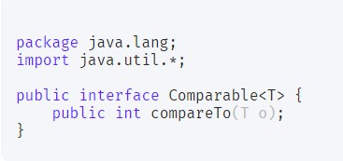
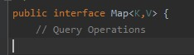
GENERIC
- Generic Interface
Comparable là một ví dụ khá dễ hiểu về Generic Interface
- Chúng ta cũng có thể truyền nhiều Type – Parameter.

Slide 9
GENERIC
Generic Wildcards
+ Là đại diện cho 1 type không xác định, ký hiệu là ( ? ). Nó có thể được sử dụng như một type-parameter, field hoặc là kiểu trả về của method, …
+ Chúng ta không thể sử dụng wildcard để truyền cho phương thức hoặc khởi tạo một generic class.
Một số loại Generic Wildcards
+ Extend Wildcard
+ Super Wildcard
+ Unbounded Wildcard

Slide 10
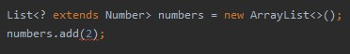
GENERIC
Extend Wildcard
Có dạng < ? extends T >, chấp nhận bất kỳ đối tượng nào miễn là đối tượng này kế thừa từ T hoặc là đối tượng của T.
Một quy tắc quan trọng cần ghi nhớ về extend wildcard là chúng ta sẽ không thể thêm các phần tử ( trừ null vì null tham chiếu đến mọi kiểu ) vào Collection được khai báo với extend wildcards.
Từ khóa extend ở đây sẽ đại diện cho cả sub-class, sub-interface và interface implementations .
🡺 Sử dụng extend wildcard khi bạn muốn get giá trị từ một collection và không add giá trị vào đó.

Slide 11
GENERIC
Super Wildcard
Có dạng < ? super T >
Cho phép truyền vào type parameter là T hoặc super-type của nó.
Chúng ta có thể add element vào collection, tuy nhiên nó phải có kiểu là T.
.
🡺 Sử dụng super wildcard khi bạn chỉ muốn add element vào và không get bất kì 1 phần tử nào trong đó.
🡺 Không sử dụng extend wildcard hoặc super wildcard trong TH vừa add vừa get element.

Slide 12
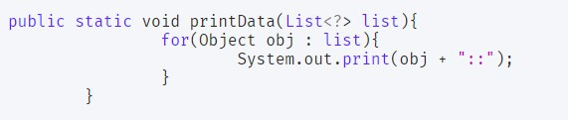
GENERIC
UnBounded Wildcard
Trong TH chúng ta muốn có một generic hoạt động với mọi type-parameter. Lúc này unbounded sẽ được sử dụng, nó giống như chúng ta dùng < ? extend Object >

Slide 13
GENERIC
Một số hạn chế của Generic:
+ Generic Type không hỗ trợ Primitive Type
+ Không thể khởi tạo instance của Type-Parameter.
+ Không thể khai báo một biến static với type là type-parameter.
+ Không thể overload 1 phương thức trong TH type erase nó có cùng signature.
+ Không thể khởi tạo 1 mảng Generic

Slide 14
Anonymous class

Slide 15
Nested class
Class được định nghĩa trong 1 class khác
Được coi là 1 member của class ngoài nó
Có thể truy cập gần như tất cả member của class ngoài, kể cả private
Notes:
Truy cập: trừ trường hợp của static nested

Slide 16
2 loại
Static nested class: nested class được khai báo static
Inner class
Notes:
Bài này chỉ nói về Inner

Slide 17
Inner class
- Có tất cả đặc điểm của Nested class
- Không khai báo được static (trừ final) ở trong
- Có thể truy cập trực tiếp static, non-static member của class ngoài
- Liên kết chặt chẽ với class ngoài
Notes:
Các điểm khác static nested class

Slide 18
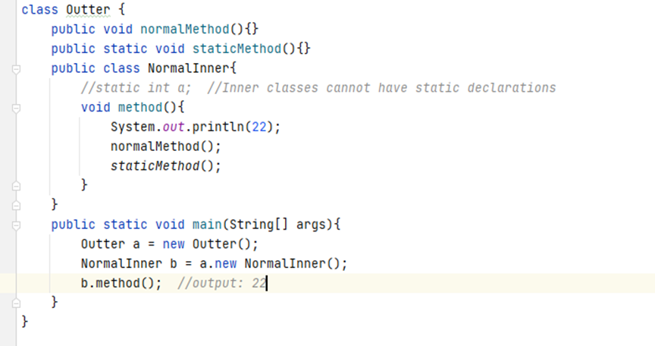

Slide 19
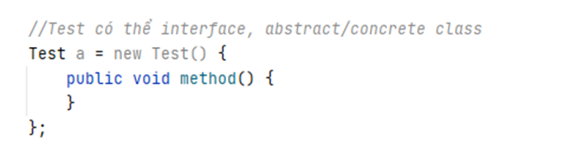
Anonymous (inner) class
Inner class không có tên, 1 object duy nhất được tạo ra

Slide 20
Mục đích
Tiết kiệm code
Tạo ra 1 instance với mục đích nhất định, dùng 1 lần
Best practices
Notes:
1: ko cần tạo class cụ thể
2: override method chỉ để dùng 1 lần
3: trình bày sau

Slide 21
3 loại
Extend class
Implement interface
Định nghĩa trong tham số truyền vào (method, constructor)
Notes:
1: ko cần tạo class cụ thể
2: override method chỉ để dùng 1 lần
3: trình bày sau

Slide 22
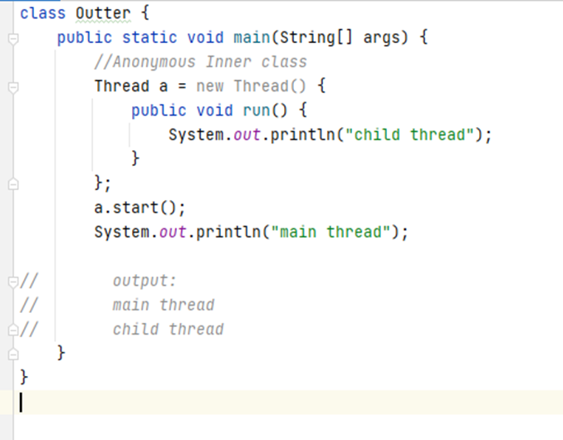
Extend class Thread
Notes:
ko cần tạo 1 class khác extend Thread
a ko phải đối tượng của Thread, mà là của anonymous class kế thừa Thread

Slide 23
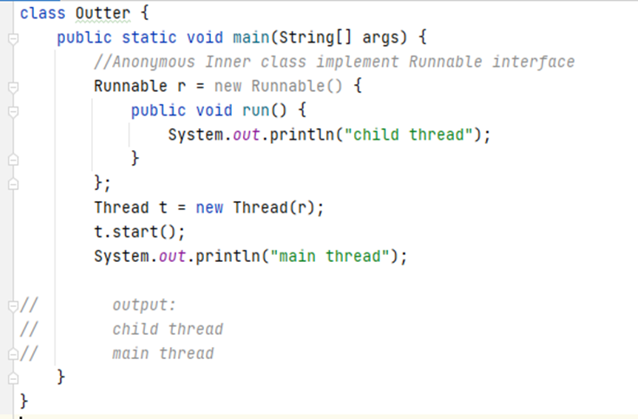
Implement interface Runnable
Notes:
tương tự

Slide 24
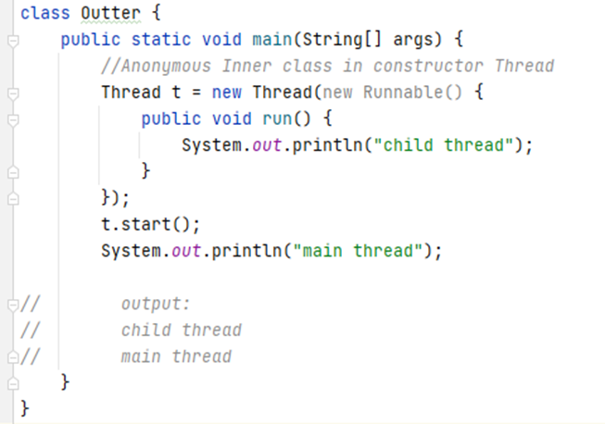
Tham số truyền vào
Notes:
Ở trên là vd về thread nhưng thường dùng trong GUI application
Vd: tạo ra 1 nút (button) mới có mục đích gì…..

Slide 25
Lưu ý
Chỉ được (extend 1 class) hoặc implement 1 class hoặc interface duy nhất

Slide 26
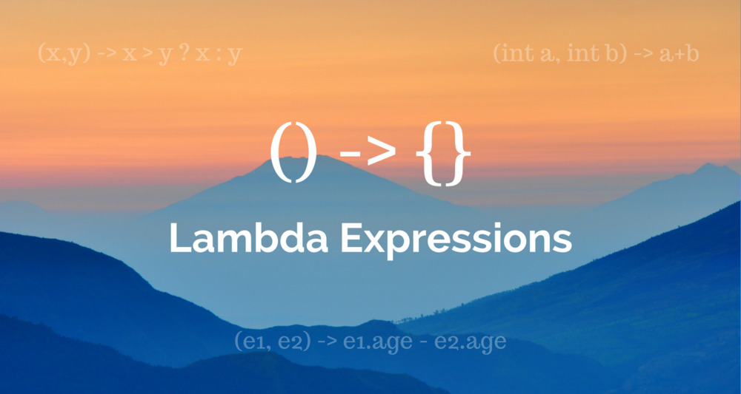

Slide 27
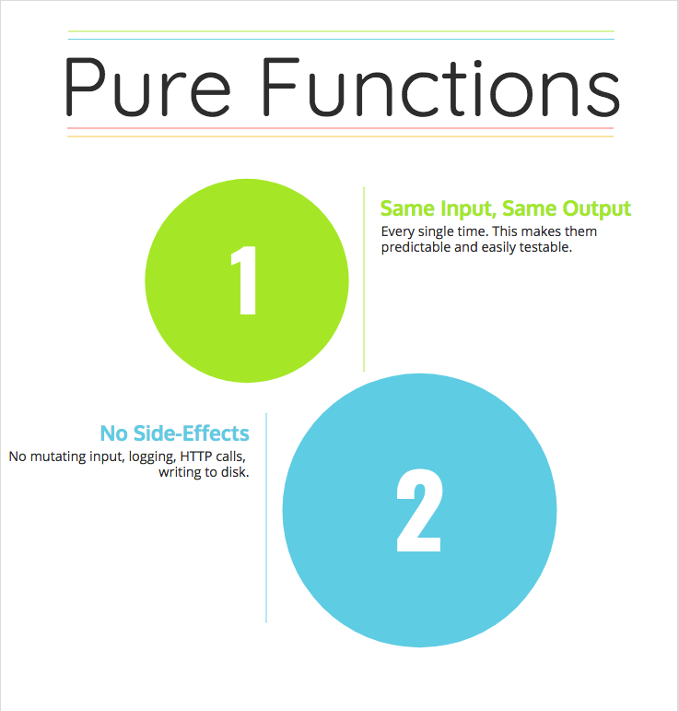
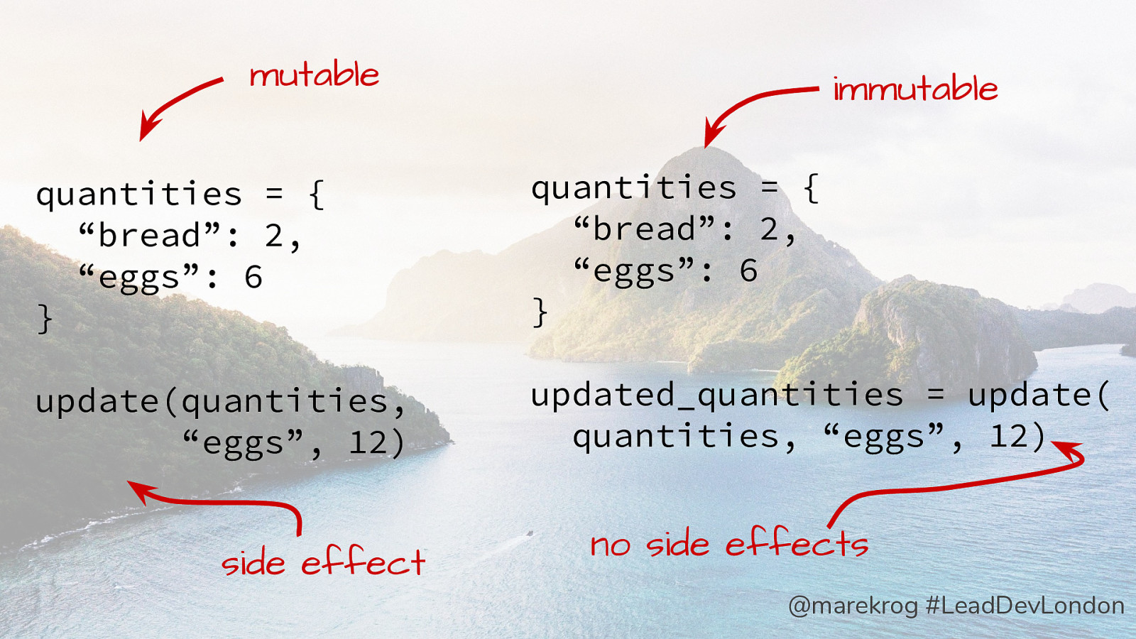
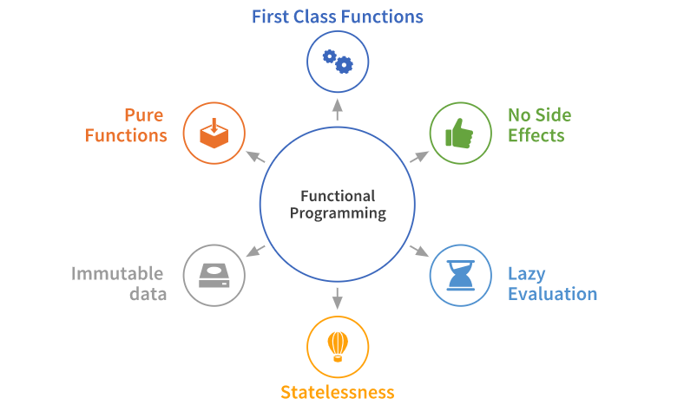
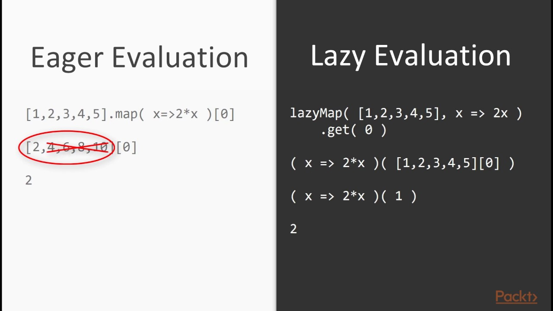
Functional Programming

Slide 28
1. What is Lambda Expression?
Anonymous function can be handled as first-class language citizen
Short block of codes which takes in parameters and returns a value
Added in Java 8

Slide 29
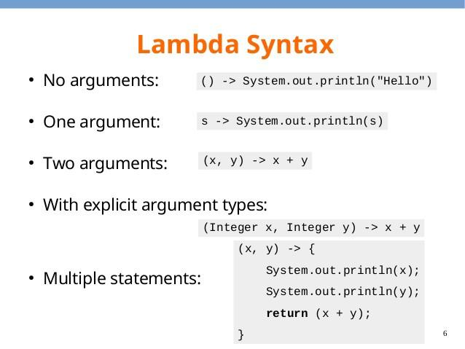
2. Syntax

Slide 30
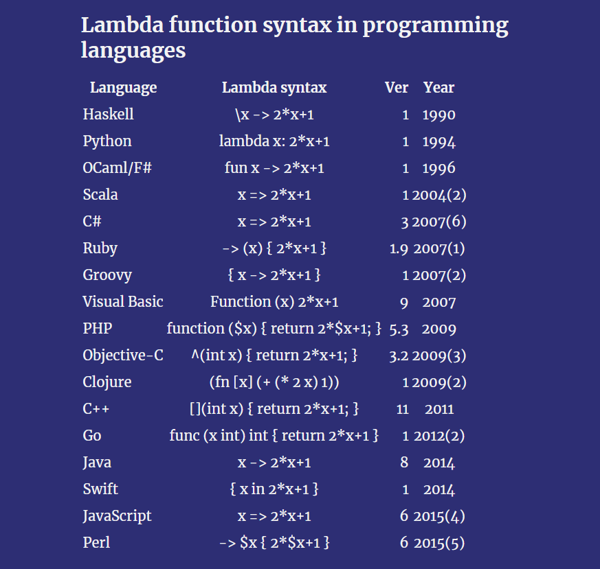
3. Lambda Expression in other languages

Slide 31
4. Why Lambda Expression?
Enables functional programming
Readable and concise code
Easy-to-Use APIs and Libraries
Enables support for parallel processing

Slide 32
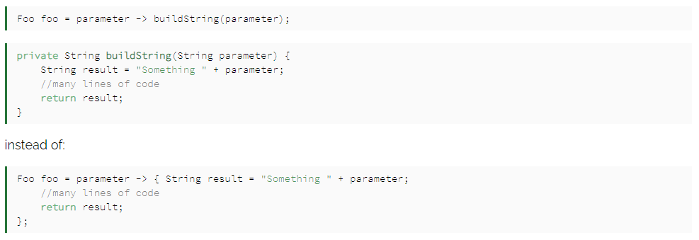
5. Best Practice
Keep lambda expressions short and self-explanatory
Avoid block of codes in lambda’s body

Slide 33
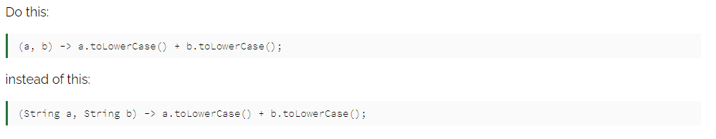
5. Best Practice
Avoid specifying parameter types

Slide 34
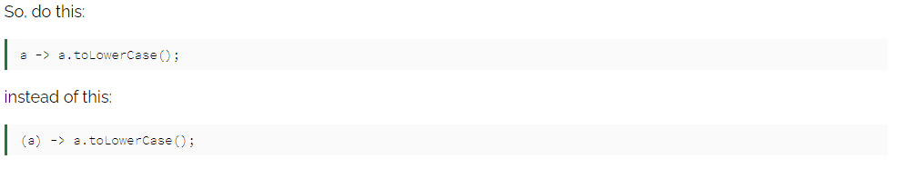
5. Best Practice
Avoid () around single parameter

Slide 35
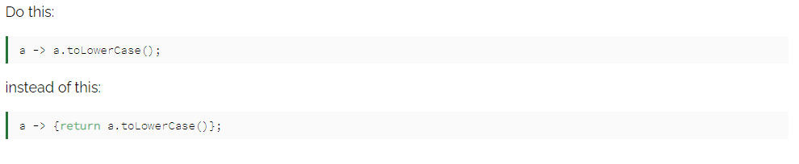
5. Best Practice
Avoid {} and return statement in one-line lambda body

Slide 36
5. Best Practice
Use method references

Slide 37
6. Method references
Short and more readable alternative for lambda expression which only calls existing method
4 variants of method references

Slide 38
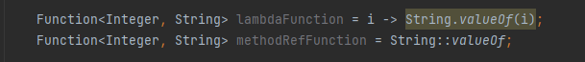
6.1 Reference to static method
ContainingClass::methodName

Slide 39
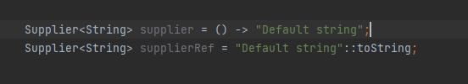
6.2 Reference to instance method
ContainingInstance:methodName

Slide 40
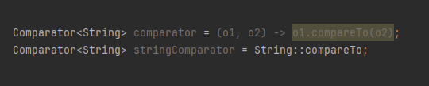
6.3 Reference to instance method of arbitrary object of particular type
ContainingType::methodName

Slide 41
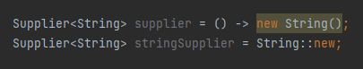
6.4 Reference to Constructor
Classname::new

Slide 42
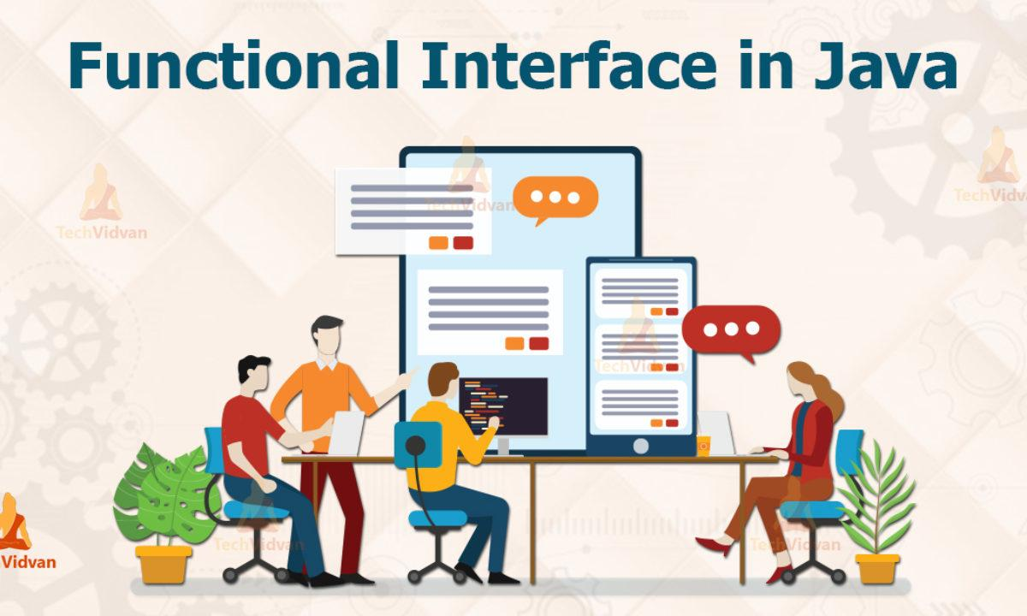

Slide 43
1. What is Functional Interface?
Interface with SAM (Single Abstract Method)
Lambda expression can be passed if a method is accepting a functional interface

Slide 44
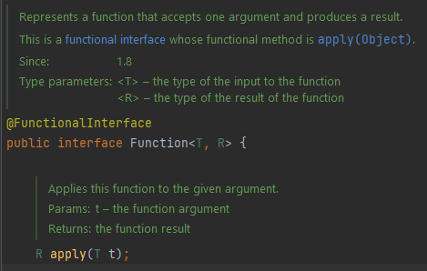
2. Syntax

Slide 45
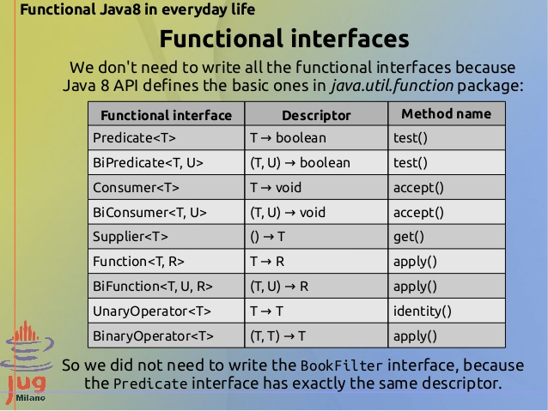
4. Built-in functional interface

Slide 46
5. Best practice
Prefer built-in functional interfaces

Slide 47
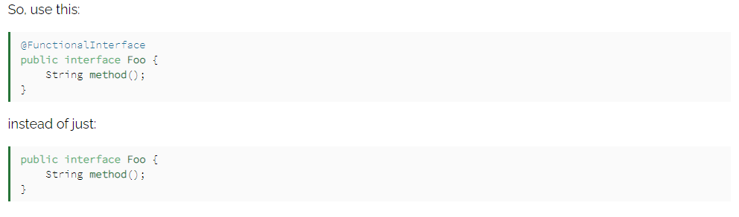
5. Best practice
Use @FunctionalInterface annotation

Slide 48
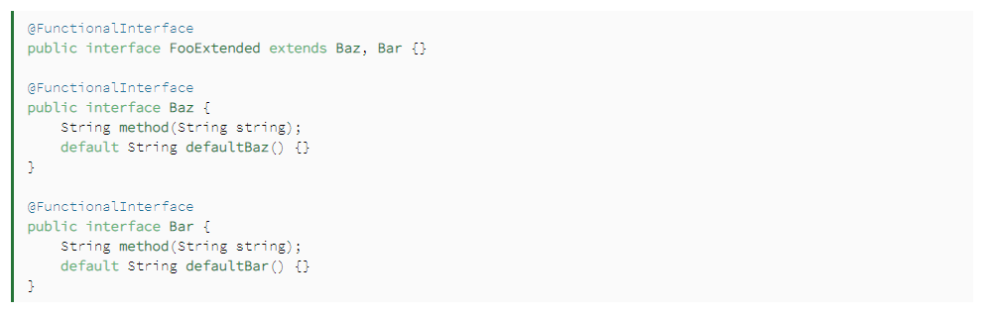
5. Best practice
Avoid overusing default methods

Slide 49
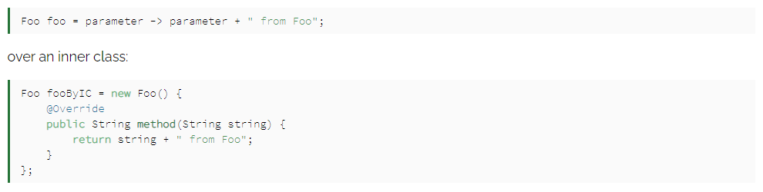
5. Best practice
Instantiate functional interfaces with lambda expression:

Slide 50
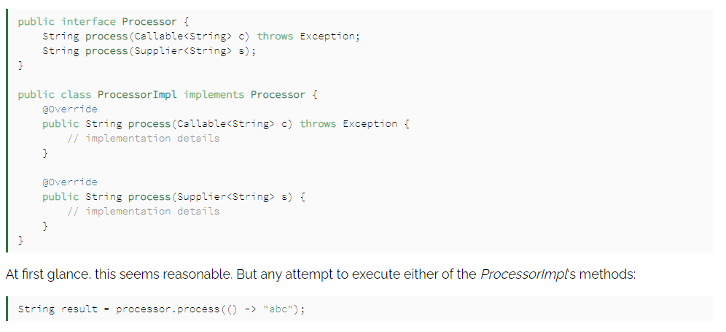
5. Best practice
Avoid overloading methods taking functional interfaces as parameters

Slide 51
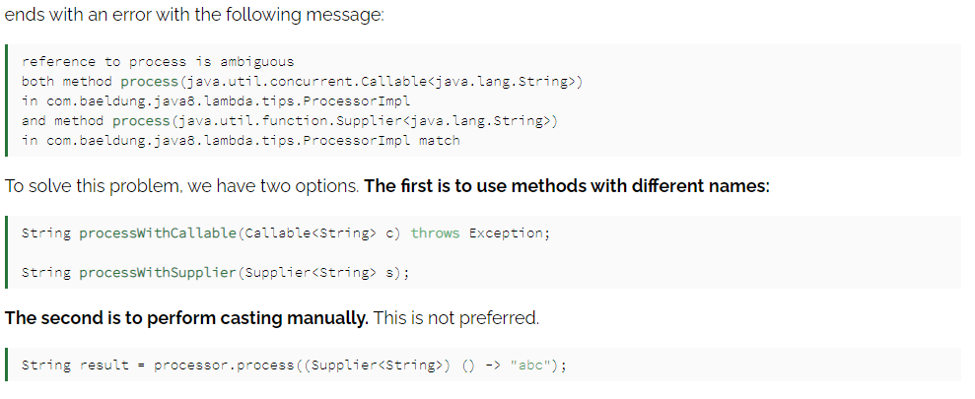
5. Best practice
Avoid overloading methods taking functional interfaces as parameters

Slide 52
STREAM

Slide 53
Introduction
Java Stream is a class to support functional-style operations on streams of elements, such as map-reduce transformations on collections.
Streams differ from collections:
No storage: A stream is not a data structure that stores elements
Functional in nature: A stream operation produces a result, but not modify its source
Laziness-seeking: until we call a terminal operation, our stream won’t be doing anything
Possibly unbounded: While collections have a finite size, streams need not
ex: stream iterate(), generate()
Consumable: Like Iterator behavior, the elements of a stream are only visited once

Slide 54
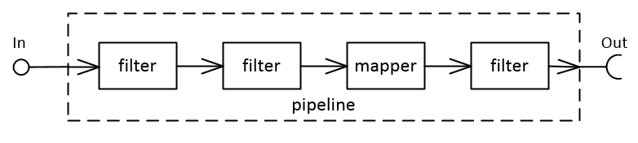
Introduction
A stream pipeline is the operations that run on a stream to produce a result

Slide 55
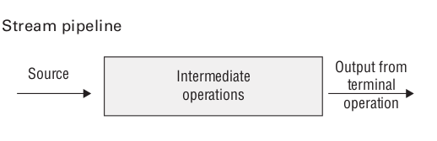
Introduction
A stream pipeline contains 3 parts:
Source: Where the stream comes from.
Intermediate operations: Transforms the stream into another one
Lazy evaluation: intermediate operations do not run until the terminal operation runs
Stateless ops: retain no state from prev element when processing a new element
Stateful ops (like distinct() or sorted()): may incorporate state from prev element when processing a new element
Terminal operations: Actually produces a result, stream is no longer valid after a terminal operation completes (else InvalidStateException)

Slide 56
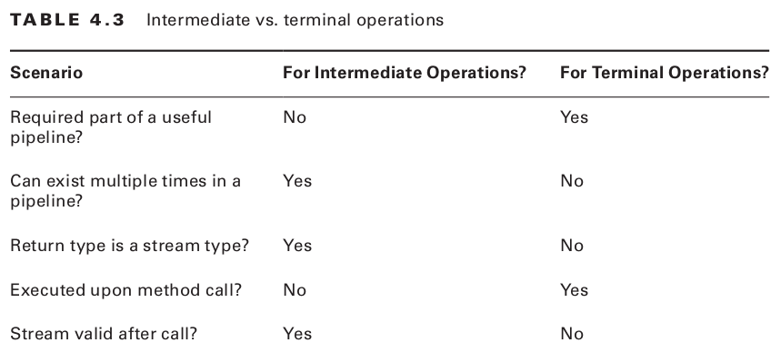
Introduction
A stream pipeline contains 3 parts: Source, Intermediate and Terminal operations

Slide 57
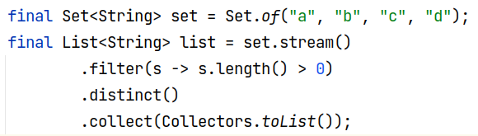
Introduction
How stream works internally?
Stream operations are stored internally using a Linked List structure
Each stage gets assigned a bitmap that follows some characteristics: ORDERED, DISTINCT, SORTED, SIZED, … => for stream optimisation
ex: filter() clears SIZED flag as size might have changed, but preserves SORTED, DISTINCT
ex: stream cleverly skip that stage making use of the flags DISTINCT

Slide 58
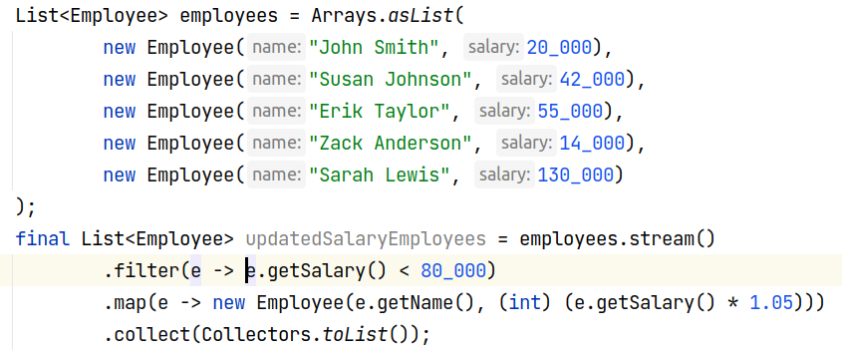
Introduction
Execution of stateless pipelines
Notes:
demo generalStream.streamInternal2()

Slide 59
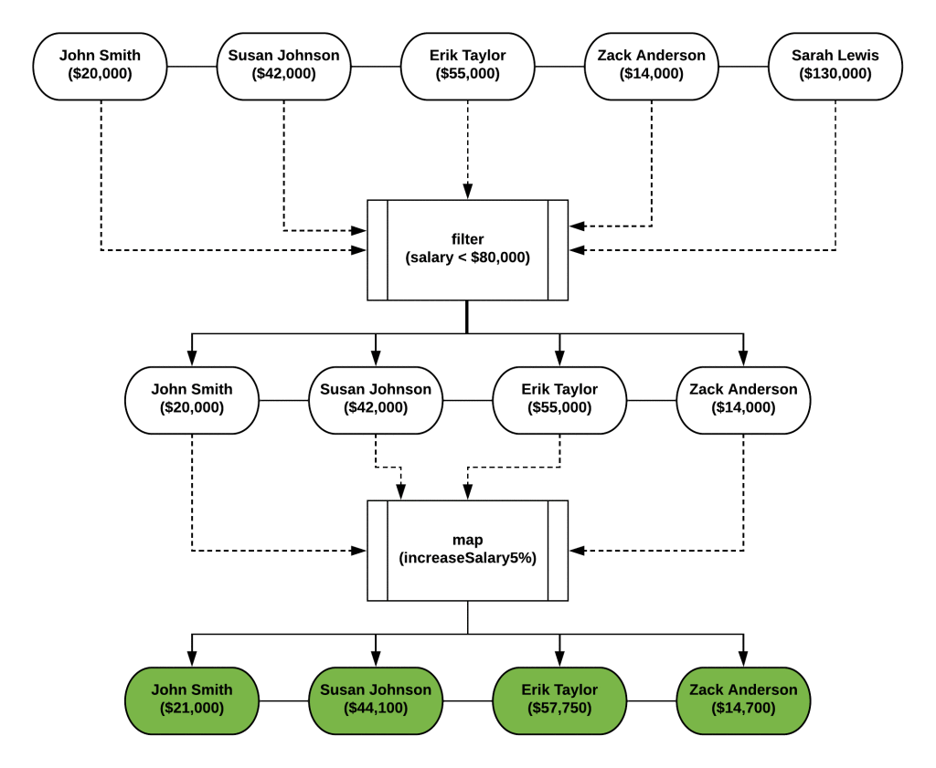
Introduction
Execution of stateless pipelines
(Expectation)

Slide 60
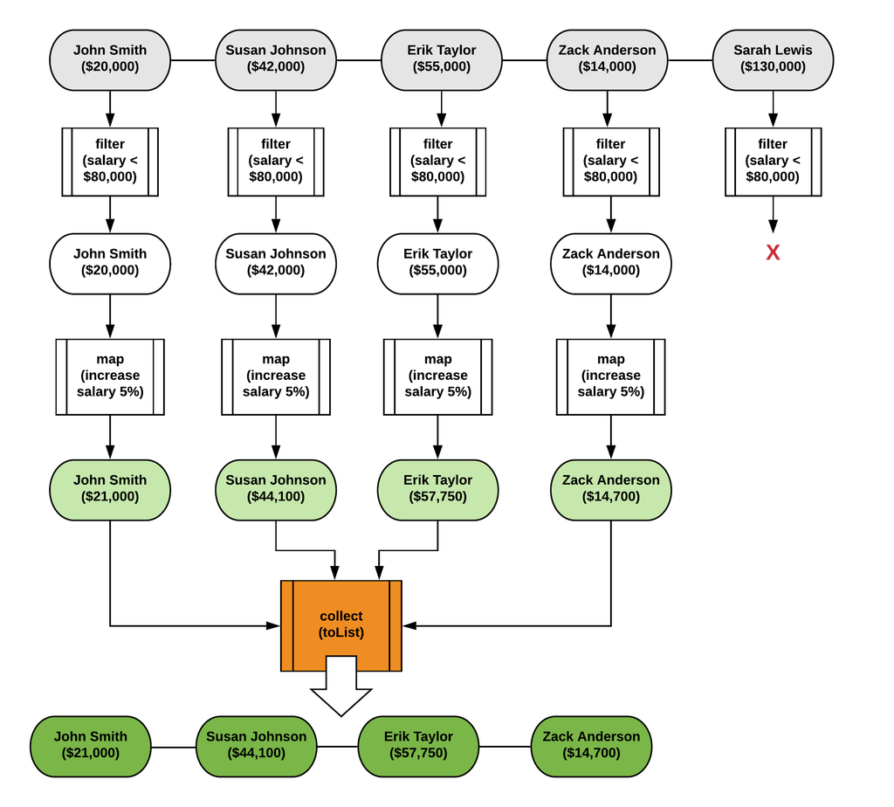
Introduction
Execution of stateless pipelines
(Reality)
Notes:
parallel processing is very safe and straightforward by following this type of processing, that’s why we can convert a stream to a parallel stream very easily!

Slide 61
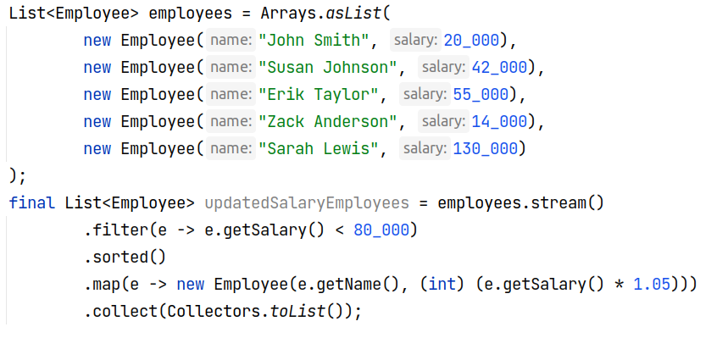
Introduction
Execution of stateful pipelines: buffers all the elements until it reaches the last element and then it emits a result.
Notes:
The sorted method cannot emit a result until all the elements have been filtered, so it buffers them before emitting any result to the next stage
demo generalStream.streamInternal2()

Slide 62
Stream Creation
Finite Stream
1: Stream<String> empty = Stream.empty(); // count = 0
2: Stream<Integer> singleElement = Stream.of(1);
3: Stream<Integer> fromArray = Stream.of(1, 2, 3);
4: Stream<String> fromList = Arrays.asList("a", "b", "c").stream();
5: Stream<String> fromListParallel = Arrays.asList("a", "b", "c").parallelStream();
Infinite Stream
7: Stream<Double> randoms = Stream.generate(Math::random);
8: Stream<Integer> oddNumbers = Stream.iterate(1, n -> n + 2);
Notes:
generate -> constant stream or stream of random variable
demo

Slide 63
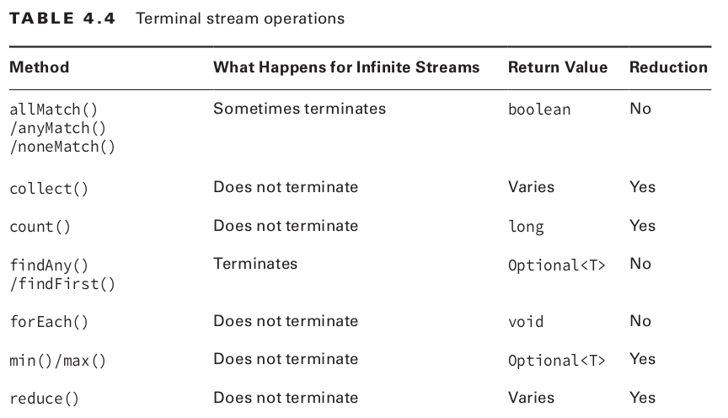
III. Common Terminal Operations

Slide 64
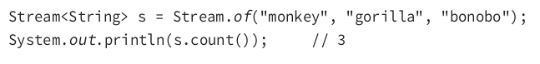
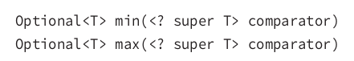


III. Common Terminal Operations
count() determines number of elements in finite stream. For an infinite stream, it hangs
max()/min() find the max, min value in finite stream according to the sort order from comparator passed in

Slide 65


III. Common Terminal Operations
findAny()/findFirst() return an element of the stream. If stream is empty -> return empty Optional

Slide 66


III. Common Terminal Operations
allMatch()/anyMatch()/noneMatch() search a stream and return boolean information about how the stream pertains to the predicate

Slide 67

III. Common Terminal Operations
forEach() constructs a loop
calling forEach() on an infinite stream does not terminate since there is no return value
Streams cannot use a traditional for loop to run because they don’t implement the Iterable interface.
.forEach() vs .stream().forEach()?
The former uses Iterable.forEach (order defined), while the other uses Stream.forEach (undefined order)
stream().forEach() uses Spliterator -> extra setup overhead
Notes:
Collection.forEach() uses the collection's iterator (if one is specified) ~ Iterable.forEach(). That means that the processing order of the items is defined. In contrast, the processing order of Collection.stream().forEach() is undefined.
Stream vs loop
Performance
Readability trade-off -> Maintainability

Slide 68

III. Common Terminal Operations
reduce() combines a stream into a single object
identity: initial value for an accumulator, or a default value if a stream is empty
accumulator: function which specifies the logic of the aggregation of elements
creates a new value for every step of reducing -> not efficient
combiner: aggregates the results of the accumulator,
useful in parallel mode -> reduce accumulator results from different threads

Slide 69


III. Common Terminal Operations
reduce() combines a stream into a single object
is equivalent to

Slide 70

III. Common Terminal Operations
reduce() 2nd signature: Optional<T> reduce(BinaryOperator<T> accumulator)
Identity not specified -> Optional is returned as there may not be any data
If the stream is empty, an empty Optional is returned.
If the stream has one element, it is returned.
If the stream has multiple elements, the accumulator is applied to combine them.

Slide 71
III. Common Terminal Operations
reduce() 3rd signature:
identity: initial element
accumulator: function takes a partial result and next element -> produces new partial result
combiner: function combines two partial results to produce a new partial result.

Slide 72

III. Common Terminal Operations
collect() modifies, or mutates, an existing value
More efficient than reduce() because same mutable object is used while accumulating
1st signature: specify how collecting should work
supplier: constructs new instances
accumulator: fold an element into a result container
combiner: accepts 2 partial result containers and merges them (useful in parallelism)
2nd signature: Java provides an interface with common collectors

Slide 73


III. Common Terminal Operations
collect()

Slide 74

IV. Common Intermediate Operations
filter() returns a Stream with elements that match a given expression
signature: Stream<T> filter(Predicate<? super T> predicate)
distinct() returns a stream with duplicate values removed
signature: Stream<T> distinct()
Notes:
why Certain aggregate operations, such as filtering duplicates (distinct()) or grouped reductions (Collectors.groupingBy()) can be implemented more efficiently if ordering of elements is not relevant ???
-> For ordered streams, the selection of distinct elements is stable (for duplicated elements, the element appearing first in the encounter order is preserved.) For unordered streams, no stability guarantees are made.
But in case of ordered stream running in parallel distinct may be unstable - means it will keep an arbitrary element in case of duplicates and not necessarily the first one as expected from distinct otherwise.

Slide 75



IV. Common Intermediate Operations
limit()/skip() make a finite stream smaller, or make a finite stream out of an infinite stream
signature: Stream<T> limit(int maxSize) & Stream<T> skip(int n)
sorted() returns a stream with the elements sorted, Java uses natural ordering unless we specify a comparator
Notes:
limt demo

Slide 76


IV. Common Intermediate Operations
map() one-to-one mapping from the elements in the stream to the elements of the next step in the stream
signature: <R> Stream<R> map(Function<? super T, ? extends R> mapper)
peek() perform a stream operation without actually changing the stream
signature: signature: Stream<T> peek(Consumer<? super T> action)

Slide 77

IV. Common Intermediate Operations
flatMap() takes each element in the stream and makes any elements it contains top-level elements in a single stream
<R> Stream<R> flatMap(Function<? super T, ? extends Stream<? extends R>> mapper)
Notes:
demo

Slide 78

V. Handle Exception
Avoid polluting the lambda expression with the try/catch block.

Slide 79

V. Handle Exception
Try to extract the try/catch block into a separate method

Slide 80


VI. Parallel Stream
A parallel stream splits its elements into multiple substreams, processing in different threads.
Aggregate operations iterate over and process these substreams in parallel and then combine the results.
Notes:
aggregate operation ~ filter, map, flatmap, ...

Slide 81

VI. Parallel Stream
For Collection or an array, parallelStream() is used, else parallel() should be used

Slide 82
VI. Parallel Stream
How Parallel Stream works internally?
Boolean flag is set to signal that all the operations that follow the invocation to parallel
java.util.stream library uses the fork-join framework for implementing parallel execution.
ForkJoinPool.commonPool() with work-stealing as scheduling strategy
By default #threads = #processors, as returned by Runtime.getRuntime().availableProcessors()
The fork/join framework: recursively split a parallelizable task into smaller tasks then combine the results of each subtask to produce the overall result
Notes:
Note that, in reality, calling the method parallel on a sequential stream doesn’t imply any concrete transformation on the stream itself. Internally, a boolean flag is set to signal that you want to run in parallel all the operations that follow the invocation to parallel

Slide 83

VI. Parallel Stream

Slide 84
VI. Parallel Stream
When parallel stream?
parallel streams isn’t always the best choice, since it doesn’t maintain stream order
There are certain instances in which we need the code to be executed in a certain order and in these cases, we better use sequential streams to perform our task at the cost of performance
Performance difference between the two kinds of streams is only of concern for large scale programs or complex projects
-> should consider using Parallel Streams when the sequential stream behaves poorly.

Slide 85

VIII. References
Jeanne Boyarsky, Scott Selikoff - OCP Oracle Certified Professional Java SE 11 Programmer I Study Guide
Java 8 in Action Lambdas, Streams, and functional-style programming
https://developer.ibm.com/articles/j-java-streams-3-brian-goetz/
https://docs.oracle.com/javase/8/docs/api/java/util/stream/package-summary.html
https://docs.oracle.com/javase/tutorial/collections/streams/parallelism.html
https://stackoverflow.com/questions/21219667/stream-and-lazy-evaluation
https://stackoverflow.com/questions/28459498/why-are-java-streams-once-off
http://mail.openjdk.java.net/pipermail/lambda-libs-spec-experts/2012-November/000412.html
https://medium0.com/swlh/the-unfairly-unknown-forkjoinpool-c262777def6a

